Slide 1

NYC Housing Price Prediction
Team 4:
Priyank Jagad
Praneetha Moturi
Abhiram Yenugadhati
Aanchal Agarwal

Slide 2

Introduction
Price prediction of properties is one of the most important applications in real estate as the housing market goes through a lot of up-and-downs due to volatile economic cycles.
The aim of this project is to predict the house listings prices in New York City as that is where housing prices are most volatile.
To achieve this prediction, We have implemented different models with different levels of accuracy.

Slide 3
System Design
Dataset
Data Preprocessing
Visualization
Modelling

Slide 4
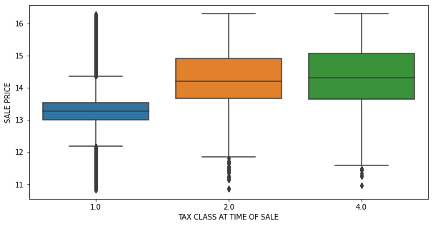
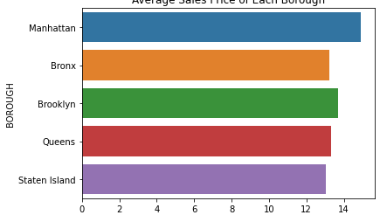
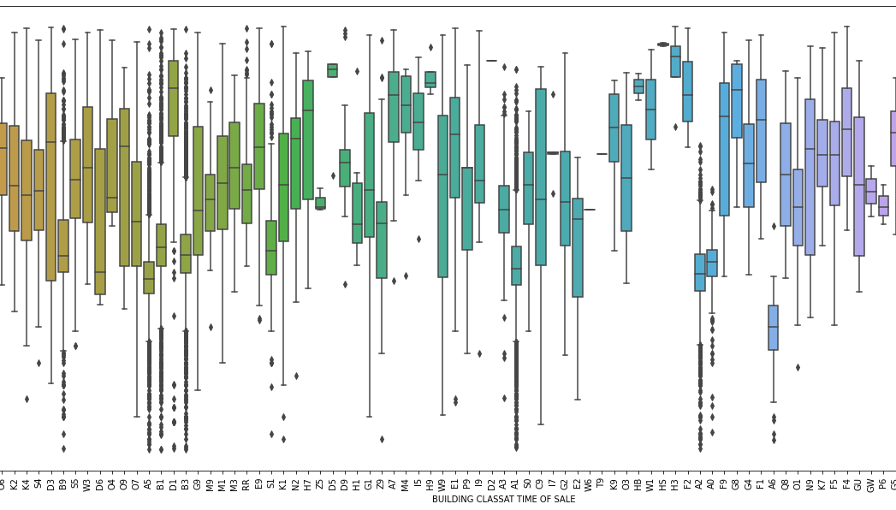
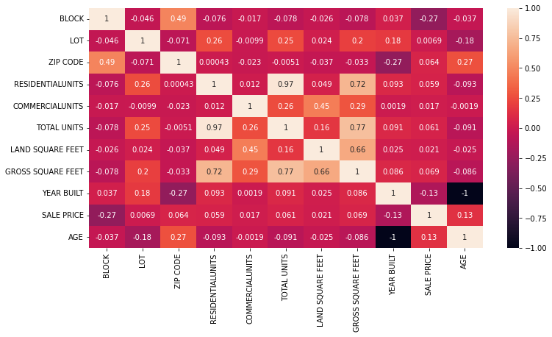
Data Visualization
For visualization, We discussed the best possible use cases and correlation among in the data and used libraries like
Matplotlib
Seaborn

Slide 5

Dataset
The dataset has been collected from the NYC department of finance which contains information about the sale of properties in New York City for the years 2020 & 2021.
The dataset contains about 167720 property sales information pieces.
The entire data set can be found here:
NYC Finance Website

Slide 6

Models
In this Project we have implemented the below listed models:
Linear Regression
Lasso Regression
Ridge Regression
Elastic Net
XG Boost
K- Nearest Regression
Decision Tree Regression
Random Forest Regression
Cat Boost
Ada Boost

Slide 7
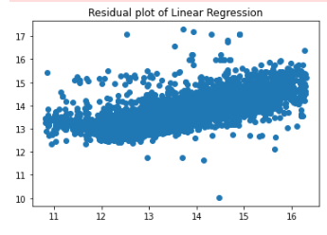
Linear Regression
Linear regression works by essentially fitting a (straight) line of best fit through the data.
Fitting lines to non-linear data will result in different levels of overprediction and underprediction.
Model | R² | MSE | RMSE
Linear Regression | 0.4814 | 0.2547 | 0.5047

Slide 8
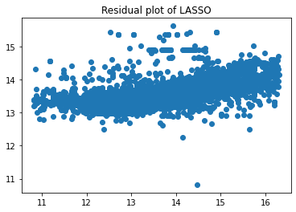
Lasso Regression
Lasso regression is a type of linear regression that uses shrinkage(data values are shrunk towards a central point, like the mean ).
This regression is well-suited for models showing high levels of multicollinearity or when you want to automate certain parts of model selection, like variable selection/parameter elimination.
Model | R² | MSE | RMSE
Lasso Regression | 0.2909 | 0.3483 | 0.5902

Slide 9
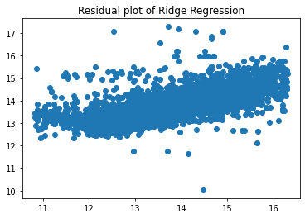
Ridge Regression
Ridge regression is an approach to develop a parsimonious model.
Ridge regression employs a ridge estimator, which especially good at improving the least-squares estimate when multi-collinearity is present.
Model | R² | MSE | RMSE
Ridge Regression | 0.4818 | 0.2545 | 0.5045

Slide 10
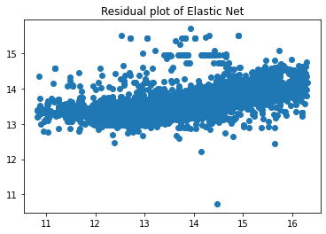
Elastic Net
Elastic net linear regression uses the penalties from both the lasso and ridge techniques to regularize regression models
The elastic net approach allows "n" variables to be included until saturation is reached. If the variables are highly connected groups, lasso will usually pick one from each group and ignore the others.
Model | R² | MSE | RMSE
Elastic Net | 0.2978 | 0.3450 | 0.5873

Slide 11
XGBoostRegression
XGBoost is a popular and efficient open-source implementation of the gradient boosted trees algorithm
XGBoost combines a convex loss function (based on the difference between the anticipated and target outputs) with a penalty term for model complexity to minimize a regularized (L1 and L2) objective function (in other words, the regression tree functions).
Model | R² | MSE | RMSE
XGBoostRegression | 0.6544 | 0.1697 | 0.4120

Slide 12
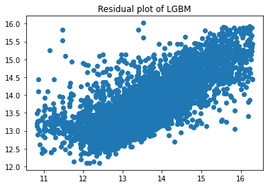
Light GBM Regression
LightGBM improves on the gradient boosting technique by incorporating automatic feature selection and concentrating on boosting examples with larger gradients.
when working with tabular data for regression and classification predictive modeling tasks, LightGBM has become the de facto approach for machine learning contests.
Model | R² | MSE | RMSE
Light GBM Regression | 0.6290 | 0.1822 | 0.4269

Slide 13
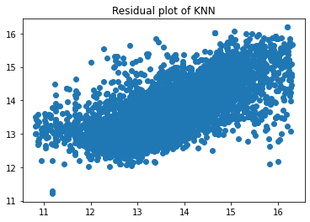
K-Nearest Neighbors Regression
KNN regression is a non-parametric method that approximates the relationship between independent variables and continuous outcomes by averaging data
The analyst must set the size of the neighborhood, or it can be decided using cross-validation (which we will see later) to find the size that minimizes the mean-squared error.
Model | R² | MSE | RMSE
K-Nearest Neighbors Regression | 0.5172 | 0.2371 | 0.4870

Slide 14
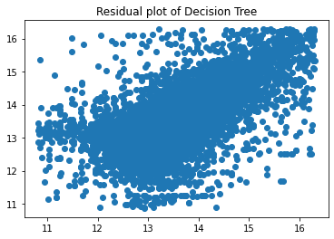
Decision Tree Regression
Decision tree builds regression models in the form of a tree structure. It incrementally breaks down a dataset into smaller and smaller sections while also developing an associated decision tree.
A tree with decision nodes and leaf nodes is the result. The topmost decision node in a tree which corresponds to the best predictor called root node.
Model | R² | MSE | RMSE
Decision Tree Regression | 0.3138 | 0.3371 | 0.5806

Slide 15
Random Forest Regression
Random Forest Regression is a supervised learning algorithm that uses ensemble learning method for regression
. It usually performs great on many problems, including features with non-linear relationships.
Model | R² | MSE | RMSE
Random Forest Regression | 0.6298 | 0.1818 | 0.4264

Slide 16
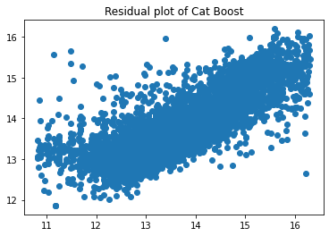
Cat Boost Regression
CatBoost builds upon the theory of decision trees and gradient boosting fits the decision trees sequentially
The fitted trees will learn from the mistakes of former trees and hence reduce the errors. . It usually performs great on many problems, including features with non-linear relationships.
Model | R² | MSE | RMSE
Cat Boost Regression | 0.3496 | 0.3195 | 0.5652

Slide 17
Ada Boost Regression
AdaBoost (Adaptive Boosting) is a very popular boosting technique that aims at combining multiple weak classifiers to build one strong classifier.
AdaBoost uses an iterative approach to learn from the mistakes of weak classifiers and turn them into strong ones.
Model | R² | MSE | RMSE
Ada Boost Regression | 0.6382 | 0.1777 | 0.4216

Slide 18

Best Model Evaluation
Among all the models that were trained and implemented, XG Boost is the winner as it offers better performance on the data.
The R squared means is 0.6544 which is by far the best among all the models that were implemented.
The features that were better predicted for the highest importance in this model are the Gross square feet and the land square feet. Hence, the housing price prediction of the properties in New York City was performed.

Slide 19

Conclusion
The implemented models would accurately predict property prices in New York city
Our future scope would be to extend this prediction modelling to various states in USA
This could be further developed to API for implementation and price estimation of Real estate application
In conclusion, This project was a great learning experience, We learned new models , their implementation also working and learning as a Team

Slide 20
Thank you!!

